Slide 1
Välkommen till webbmöte berörda aktörer high value data psi
För att minimiera risken för strul föreslår vi att
Vi enbart använder ljud, dvs inte video, i samtalet
Vi stänger av mikrofonerna
Frågor skickas till psi@lm.se så lyfter vi dem under mötet
Notes:
Jenny

Slide 2
agenda
Vårens tidplan och aktuella frågor
Återkoppling webinar KOM
Användarsynpunkter
Rapport och presentation av förslag av datamängder
Avstämning ESV
Nästa WS
Ev Övriga frågor
Notes:
Jenny

Slide 3
tidsplan
Tider för leveranser och deadlines under våren.
De båda remisserna avser tid för alla utpekade i uppdraget att förankra inom sina respektive organisationer. Det är alltså ingen formell bred remiss.
Första avstämning med ESV 20/2
Deadline enkäten för användare 29/2
Sista dag för justering av sina siffror 2/3
Leverans nyttoanalys 20/3
Leverans budgetära konsekvenser 30/3
Andra avstämning med ESV 31/3?
Remiss delrapport 7/4-23/4
Delrapport till RK 8/5
Remiss slutrapport 12/5-29/5
Slutrapport till RK 12/6

Slide 4
Aktuella frågor
Kontinuerliga avstämningar med öppna-datautredningen görs och de kommer att bjudas in till nästa WS i april.
Begreppsmodellering
  Öppna data, avgiftsfria data och värdefulla data
  Maskinläsbart
  API, bulknedladdning
  ”Already open for access and re-use” – tillgängliggjorda
  Etc
  Vi ska sammanställa och skicka ut för synpunkter
  Dialog med öppna data-utredningen
Kommissionens konsult har efterfrågat kontaktperson för Sverige
Förankring av rapporten
  Personer utöver utpekade organisationer?
Presentationer - Kartdagarna 25/3 och Kommunmöte 26/3

Slide 5
Återkoppling webinar KOM

Slide 6
Task 1: Provide a methodology to identify and quantify in concrete terms the socio-economic benefits of specific high value datasets
Task 2: Define the specific high value datasets falling under the thematic categories of the Annex of the revised Directive
Task 3: Analyse the possible impacts of the changed pricing structure for reuse of high value datasets to be provided free of charge on public sector bodies and public undertakings and the markets in which they operate
Task 4: Based on the results of Task 2 and 3, refine the socio-economic analysis (socio-economic benefits, impacts and potential) for different regulatory options chosen, in the particular case of AI applications
Task 5: Assist in the preparation of the open public consultation on high value datasets, which is expected to take place in 2020, summarise the inputs received and assist in the setting up of a public hearing.

Slide 7




Introduction to the study on High Value Datasets
Impact assessment study on the list of High Value Datasets to be made available by the Member States under the PSI Directive
February, the 12th 2020

Slide 8

Agenda for this webinar
Short introduction to the study team
Objectives, scope and understanding of the assignment
Methodological approach for the data collection and analysis tasks
Timeline and planning of the activities and where/when we will need your help
Q&A

Slide 9

Short introduction to the study team

Slide 10
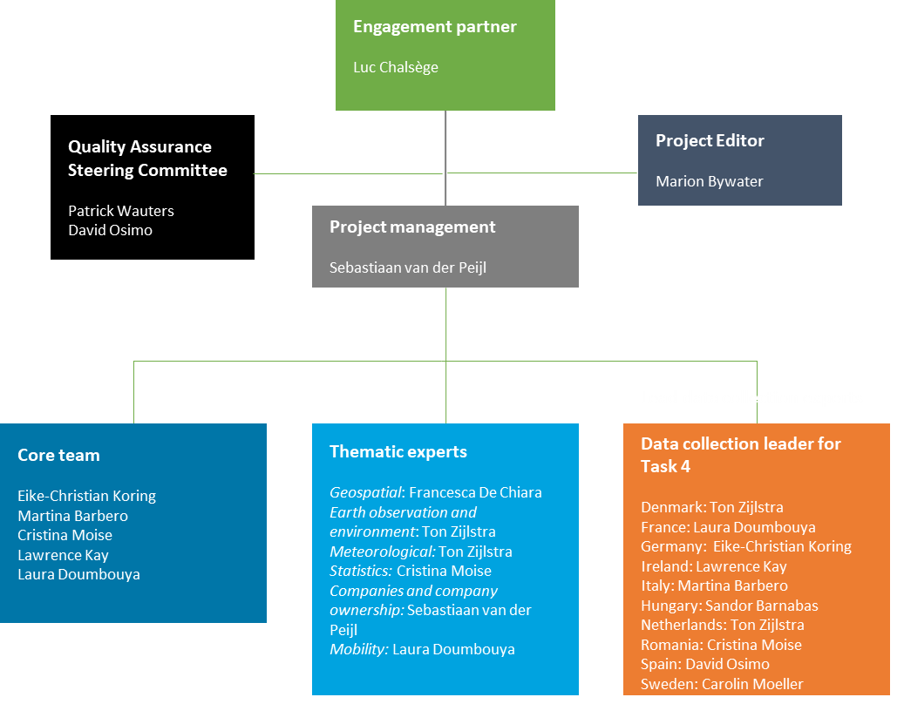
About our study team
The study team is composed by four different organisations and a number of thematic and country experts
Four different organisations with complementary expertise:
    Deloitte
    The Open Data Institute
    The Green Land
    The Lisbon Council
  We have a Project Manager and a core team composed of different profiles.
  For each thematic area and we have one thematic expert or coordinator who will be in contact with national data providers and re-users.
  For a limited set of data collection activities in the 10 shortlisted Member States (only in the context of Task 4 – further discussed below) we have lead data collection experts already identified within the study team.
Notes:
Frédéric Berger, Hans Verheggen, Éva Kamarás

Slide 11

Objectives, understanding and scope of the assignment

Slide 12
Objectives and understanding of the assignment
Objectives and scope 1/3
The overall objective of this assignment is to « define concrete High Value Datasets that fall under the thematic categories included in the Annex of the revised Directive, based on an iterative process involving a number of cycles, by which an initial broad range of datasets will be narrowed down. »
Main content scope
The categories of high value datasets identified in Annex I of the Directive (geospatial, earth observation and environment, meteorological, statistics, companies and company ownership, transport);
The other areas of legislation (at the European level) which cover the provision of certain datasets by public sector authorities and must be taken into account for ensuring that the overall legislative framework on public sector information is coherent and effective.
Additional aspects to take into account
Business models of bodies who are currently charging for data and how these will be affected by the Directive;
Competition issues for public undertakings opening up high value datasets whereas their private competitors do not have the same obligation;
Importance of high value datasets for SMEs and for building AI applications and services.
Examples of datasets in scope | Examples of datasets out of scope
All datasets covered by the INSPIRE Directive. | Datasets covered by the Intelligence Transport System Directive and by the ITS Delegated Regulations
Datasets covered by the Directive on Public Access to Environmental information. | Datasets covered by the European Commission Delegated Regulation on multimodal travel information services
Datasets covered by EU company law legislation (i.e. Anti-Money Laundering Directive, Company Law Directive …) | …
…. | ….

Slide 13
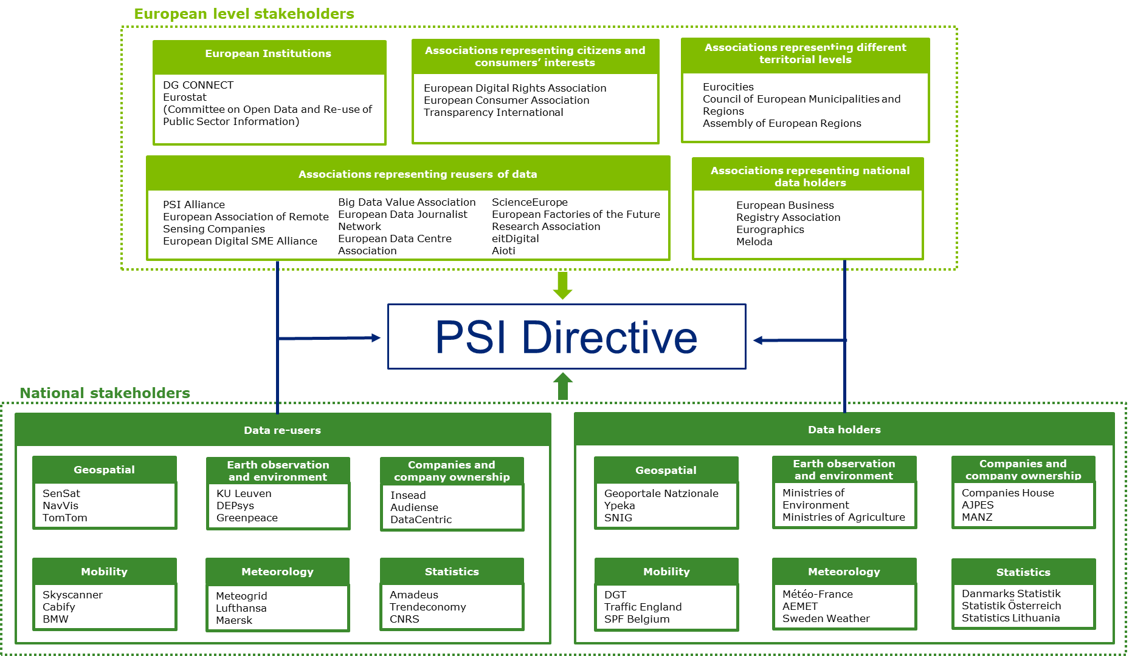
Objectives and understanding of the assignment
Understanding and scope 2/3
Stakeholders scope
We will carefully consider the two levels of stakeholders:
European level stakeholders: European Institutions, EU level associations of different types.
National level stakeholders: data reusers and data holders in particular.
Data collection activities will cover both levels and we will ask for your help for national data collection activities.

Slide 14
Objectives and understanding of the assignment
Understanding and scope 3/3
All European Member States are in scope of this assignment and the general data collection tools will cover all of them.
10 Member States will be analysed more in-depth for one task only (Task 4) and for developing and testing our economic impact model (which will nonetheless cover the entire EU).
Our suggestion of “shortlisted countries” is based on the following criteria:
    Geographical position
    Data economy value (in absolute term) and existence of an AI strategy
    Maturity in terms of provision of public sector information
    Charging and data provision practices
Shortlisted countries for Task 4 and data collection coordinators for this task
Denmark: Ton Zijlstra
France: Laura Doumbouya
Germany: Eike-Christian Koring
Ireland: Lawrence Kay
Italy: Martina Barbero
Hungary: Sandor Barnabas
Netherlands: Ton Zijlstra
Romania: Cristina Moise
Spain: David Osimo
Sweden: Carolin Moeller

Slide 15

Methodological approach for the data collection and analysis

Slide 16
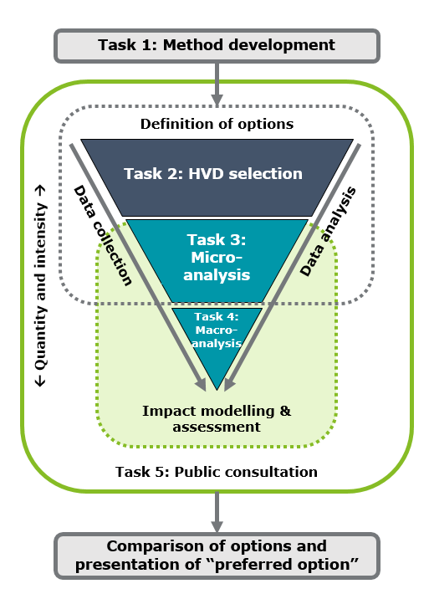
Methodology and state of play
Our general approach and key challenges
The project should not focus on “listing” High Value Datasets only but rather on characterising them
There are 2 major challenges:
    No complete list of datasets owned by governments;
    Datasets have no intrinsic value (see Task 1)
Our approach is therefore based on three pillars:
    Stakeholder involvement (through interviews and focus groups) → stakeholders will help determining the value of datasets.
    Evidence based → desk research will help establishing a good framework for identifying HVD and characterising them.
    Funnel approach (for Task 2 and Task 3) → the iterative process supports DG CNECT in getting through the various phases of discussion.

Slide 17
Methodology
Overall methodological data collection and analysis tools
Data collection tools
Data analysis methods
Desk research
Interviews
Focus groups
Team expertise
Triangulation of data
Economic modelling
Descriptive statistics
Case studies
Multi-criteria analysis
T2
Definition of HVD and presentation of possible options for regulatory intervention
T4
Finalisation of socio-economic analysis for selected policy options (macro-level analysis)
Where we are now
T1
Development of a methodology for the identification and quantification of socio-economic benefits of HVD
DATA COLLECTION & ANALYSIS
DATA COLLECTION & ANALYSIS
T3
Analysis of the possible impacts of the changed pricing structure for reuse of HVD (micro-level analysis)
T5
Public consultation and hearing
DATA COLLECTION & ANALYSIS
DATA COLLECTION & ANALYSIS
DATA ANALYSIS
Main data collection activities across tasks: interviews, online focus groups and desk research.

Slide 18

Methodology
Task 1 – Provide a methodology to identify and quantify the socio-economic benefits of High Value Datasets
We focus the framework on the 6 macro characteristics of High Value Datasets which are included in the PSI Directive definition:
Potential to generate social benefits
Potential to generate economic benefits
Potential to generate environmental benefits
Potential to generate innovation/AI
High potential for reuse
Potential to improve/strengthen/support public services and public authorities
For each of these aspects we identify specific value characteristics and for each characteristics possible quantitative and qualitative indicators as well as data sources.
Today we have a draft framework with 6 dimensions, 32 value characteristics and over 100 (qualitative and quantitative) possible indicators.
Based on desk research and stakeholders interviews we have identified a few datasets for each thematic area and we are testing them against this framework.

Slide 19
Methodology
Task 2 – Define the specific High Value Datasets falling under the thematic categories
We will provide a detailed description of the structure of each of the datasets included in the list developed under Task 1 (see table)
We will follow an iterative approach and involve stakeholders to a) validate the shortlist of datasets, b) define the datasets and the publications options, c) validate the final version of datasets and publications options,
This task will be completed through four activities:
      Activity 2.1: Assessment of the datasets and identification of the high value ones;
      Activity 2.2: First description of datasets and options;
      Activity 2.3: Validation with stakeholders and intermediary release;
      Activity 2.4: Final definition of datasets and options.
The main data collection tools for this task will be a) desk research, b) interviews and c) focus groups.
Openness-data specification | License
 | Format
 | Machine-readability
Documentation | Metadata catalogue (adherence?)
 | Metadata (dataset content description)
 | Contact info
 | Documentation
 | Documentation (dataset creation and history)
 | Shared vocabularies
Sustainability | Traceability
 | Timeliness
 | Primacy (Primary sources?)
Distribution vs. Release? | Coverage (regional/national/global)
 | API / WebService
 | automatic distribution in different formats

Slide 20
Methodology
Task 3 – Analysis of the possible impacts of the changed pricing structure
Task 3 includes the analysis of three aspects:
    Cost benefit analysis and impact on public bodies’ budget (of making the list analysed in Task 2 High Value Datasets): will be analysed through a selection of case studies covering individual data providers organisations at the national level.
    Distortion of competition (if the list analysed in Task 2 is made HVD): will be analysed through interviews with relevant stakeholders at the national level and legal analysis.
    Costs for public sector bodies and public undertakings and impact on publication arrangements (if the list analysed in Task 2 is made HVD): will be analysed through interviews with relevant stakeholders at the national level.
  Task 3 will run in parallel to Task 2 and both will follow an iterative approach.
  Task 3 looks at the « micro-level » (by considering the costs and benefits for PSBs and reusers) while contributing to the macro-level analysis of the socio-economic benefits (for Task 2 and Task 4).
We will ask your support for this task!

Slide 21
Methodology
Task 4 – Financial and socio-economic analysis at the macro-level and selection of preferred option
Interviews concerning impact modelling
Purpose: Collect quantitative information for the financial and socio-economic analyses, and validate current approach and assumptions
Step 1: Identify relevant stakeholders such as ministry officials, data holders, and data users in the Member States
Step 2: Conduct 30 interviews in 10 Member States
Impact modelling
Purpose: Identify the financial and socio-economic impacts of the policy options
Step 1: Define the key economic, social, and environmental impacts to be considered
Step 2: Conduct a financial analysis concerning costs and benefits for public bodies, businesses, citizens
Step 3: Conduct an analysis concerning socio-economic benefits and government efficiency
Final workshop
Purpose: Present the final results of the study to a selected group of stakeholders for validation
Step 1: Identify workshop participants and speakers and decide with DG CNECT
Step 2: Provide background information for participants
Step 3: Conduct the workshop and prepare a summary report
Multi-Criteria-Analysis
Purpose: Rate the policy options vis-à-vis the baseline
Step 1: Carry out a qualitative comparison of the different options (incl. the baseline scenario)
Step 2: Fine-tune the assessment in an iterative manner, liaising closely with DG CNECT
Step 3: Present the results of the analysis concerning the impacts of the policy options in a “user-friendly” format

Slide 22

Methodology
Task 5 – Public consultation and public hearing
The team will support DG CNECT in the organisation of the public consultation and public hearing and especially in the following activities:
Public consultation
    Analysis of the public consultation results
  Public hearing
    Definition of the scope and contents of the public hearing
    Organisation and logistics
    Analysis and summary of the outcomes

Slide 23

Timeline and planning and where/when we will need your help

Slide 24

Timeline and planning
Key milestones for the assignment
February
March/April/May
June/July
August/September
Finalisation and validation of the framework for HVD
Interviews with all stakeholders (for Task 2 and Task 3)
Public hearing
Final report
Preparation of all data collection activities
Online focus groups for all thematic areas
Triangulation and analysis of all data
Final Workshop
Contacting key stakeholders and multipliers (including national representatives)
Interviews for the definition of the impact model (Task 4)
Quantification of the impacts (Task 4)
Production of interim results
Draft final report

Slide 25

Where/when we will need your help
How we will interact with you
The study core team will contact you all in a couple of weeks to ask your input on:
Data providers we should interview (for the different thematic areas in scope) and their contacts (we will ask the data providers about their data re-users but feel free to provide input on reusers as well);
Possible cases studies for costs and benefits analysis at organisations level (i.e. if one of your data providers has recently stopped charging for certain datasets we are particularly interested in hearing from them);
Other national stakeholders we should speak to in order to estimate the impacts (i.e. national ministries, re-users associations at the national level).
These information will be passed on to the different thematic coordinators and national data collectors who will organise their interviews with the relevant stakeholders
All along the study, the core team will remain at your entire disposal for any question and will be able to direct you to the thematic and data collector expert which is most relevant for addressing your inquiry.
Main contact point of the core team:
Martina Barbero (mabarbero@Deloitte.com)
Laura Doumbouya
(ldoumbouya@Deloitte.com)

Slide 26

ADDITIONAL
QUESTIONS? REMARKS?

Slide 27
Thank you!

Slide 28

Deloitte refers to one or more of Deloitte Touche Tohmatsu Limited (“DTTL”), its global network of member firms, and their related entities. DTTL (also referred to as “Deloitte Global”) and each of its member firms are legally separate and independent entities. DTTL does not provide services to clients. Please see www.deloitte.com/about to learn more.
Deloitte is a leading global provider of audit and assurance, consulting, financial advisory, risk advisory, tax and related services. Our network of member firms in more than 150 countries and territories serves four out of five Fortune Global 500® companies. Learn how Deloitte’s approximately 286,000 people make an impact that matters at www.deloitte.com.

Slide 29
Inkomna Användarsynpunkter

Slide 30
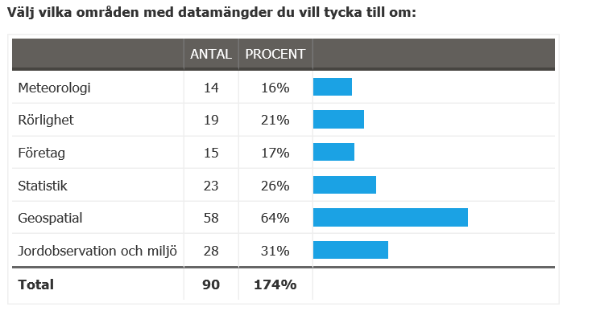
Användarsynpunkter
272 har besökt och klickat i enkäten
90 inlämnade svar

Slide 31
Användarsynpunkter
Vilken organisation representerar du? (Frivilligt)
Lantmätarstudent
Miljöförvaltningen Göteborgs Stad
Eda kommun
Remograph AB
Institutionen för Tillämpad IT, Göteborgs Universitet
Region Dalarna
Kodapan, http://kodapan.se/ OpenStreetMap, http://openstreetmap.se/ Postnummeruppror, http://postnummeruppror.nu/
Haninge kommun.
Region Halland
Lantmäteriet
Trafikverket
Trafikverket
Trafikverket
Trafikverket
Trafikverket
Trafikverket
Orienteringsklubb
Lantmäteriet: Svarar på värdefulla data utifrån min roll och min kunskap som anställd på Lantmäteriet.
HaV
Tyréns AB
Tyréns AB
Konsult (Tyréns AB)
Tyréns AB SGF Fältkommitté
Tyréns AB
Helsingborgs stad

Slide 32
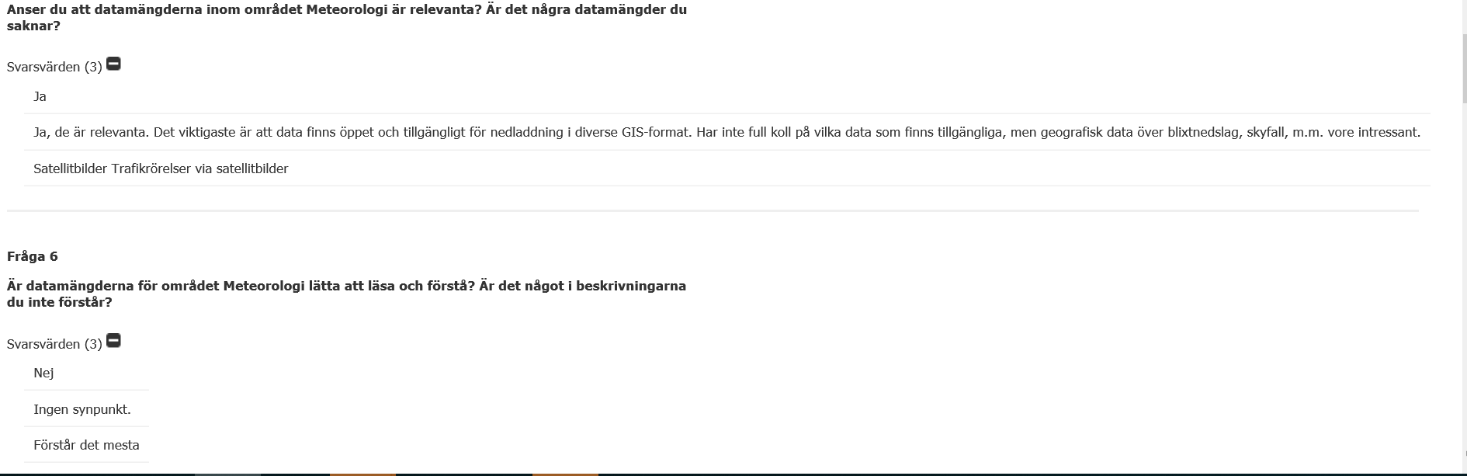
Meteorologi

Slide 33
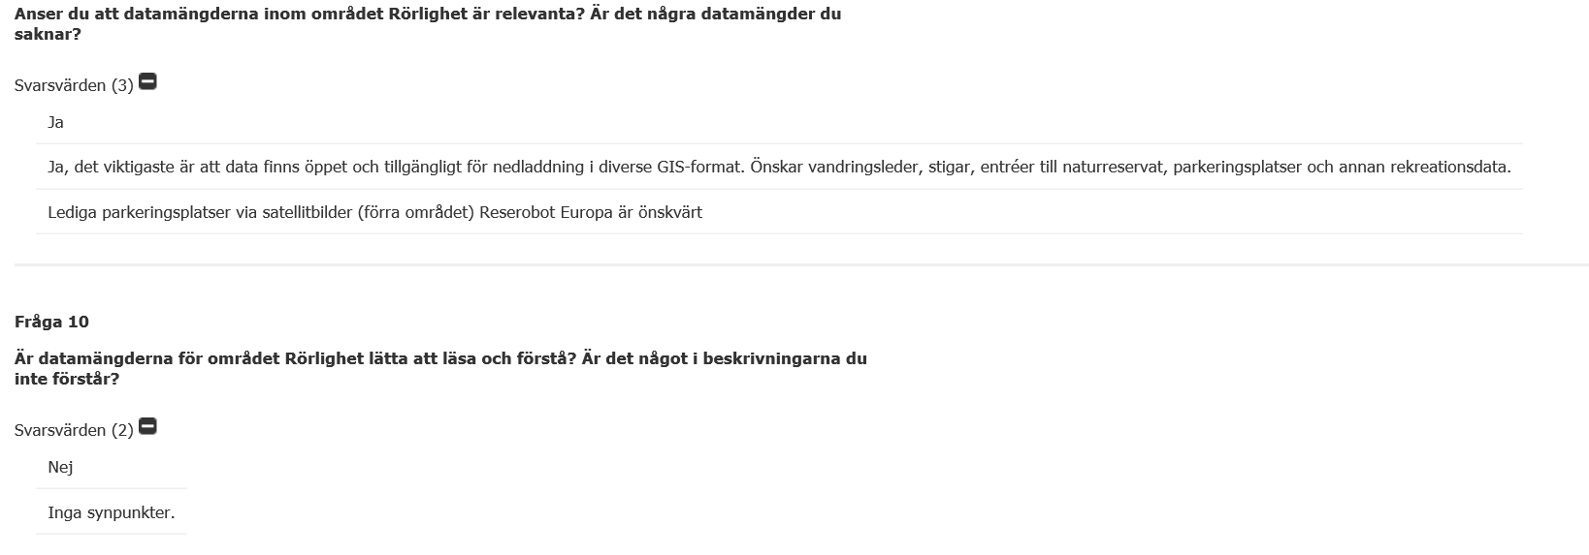
Rörlighet

Slide 34
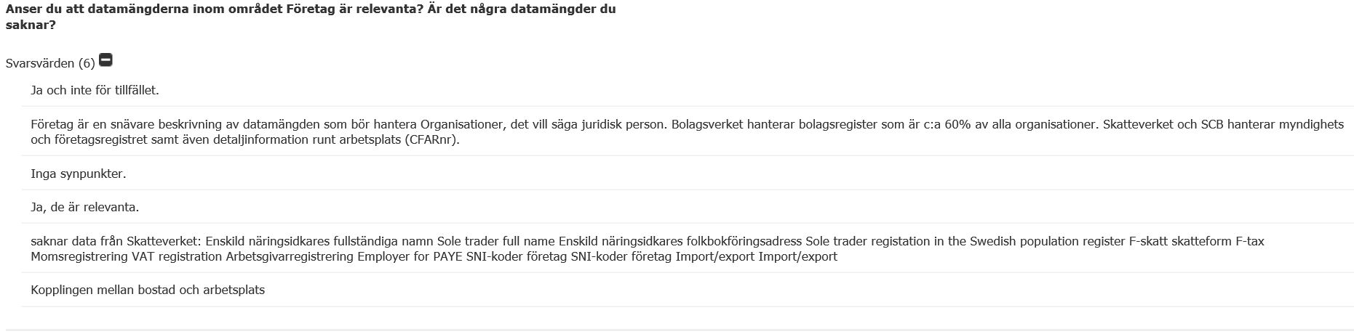
Företag och företagsägande

Slide 35
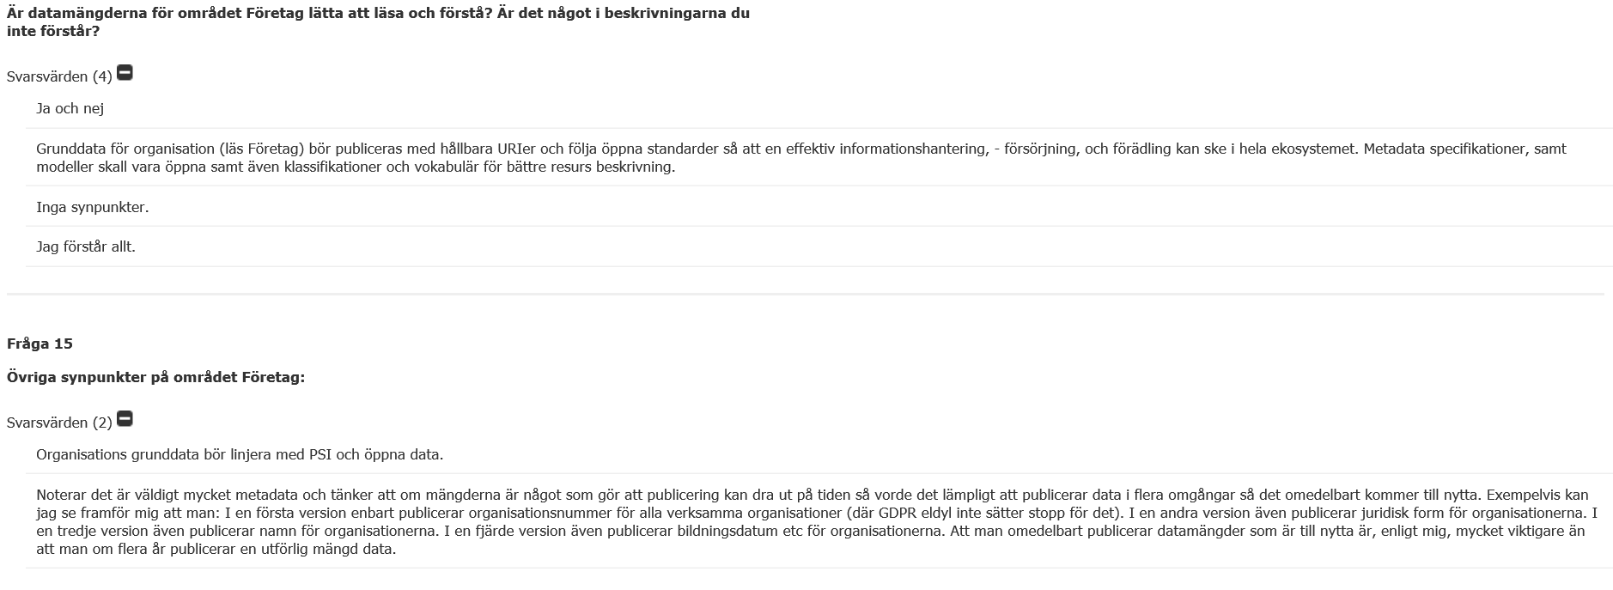
Företag och företagsägande

Slide 36
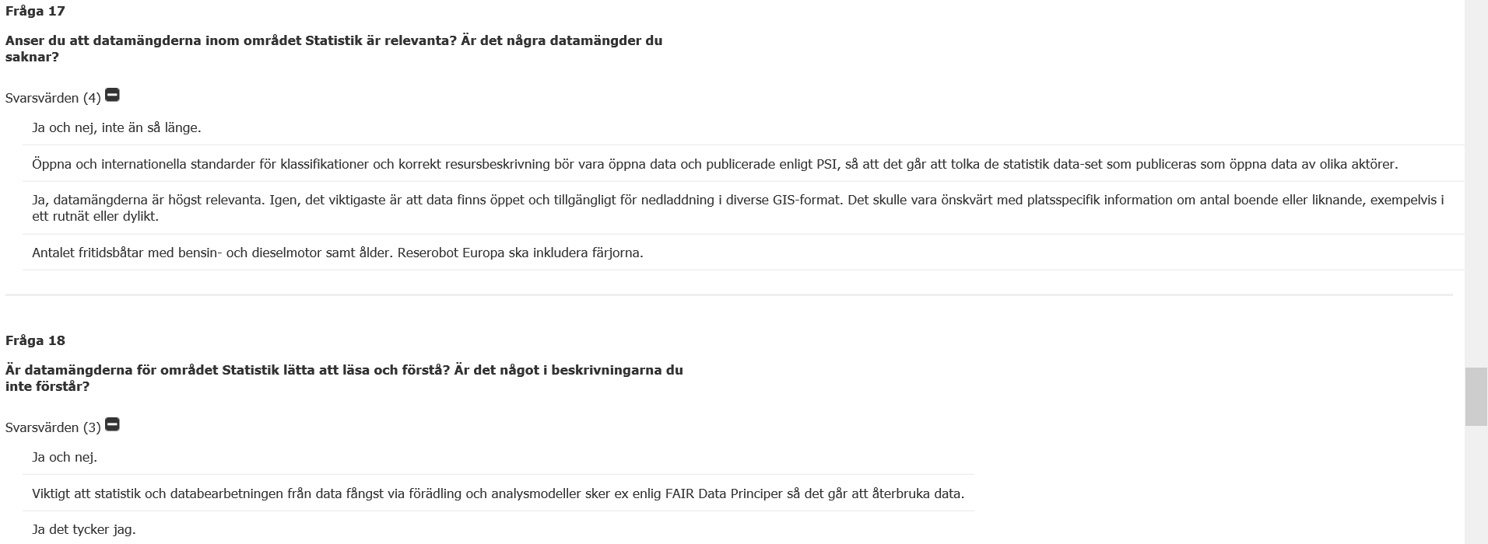
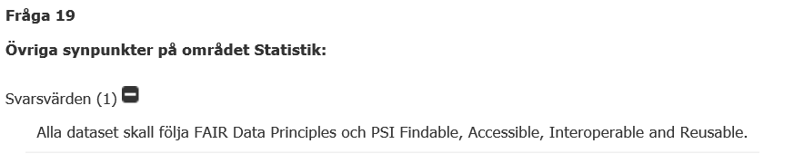
Statistik

Slide 37
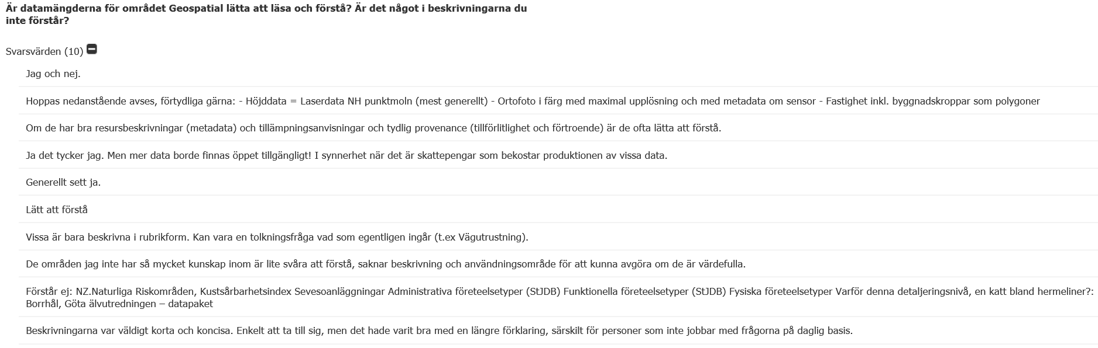
Geospatiala data

Slide 38
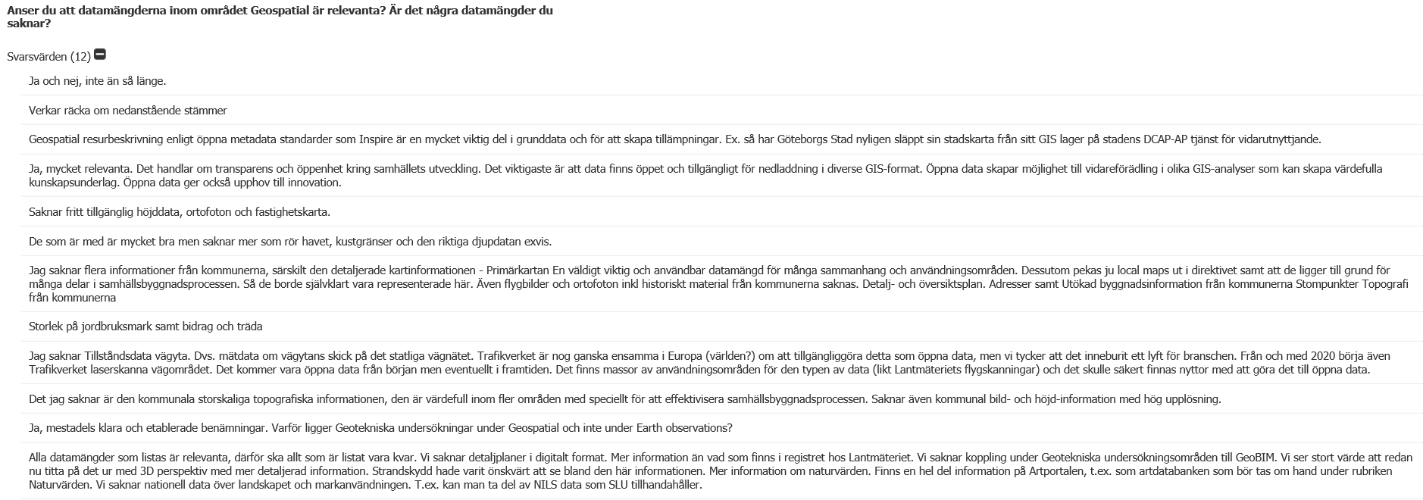
Geospatiala data

Slide 39
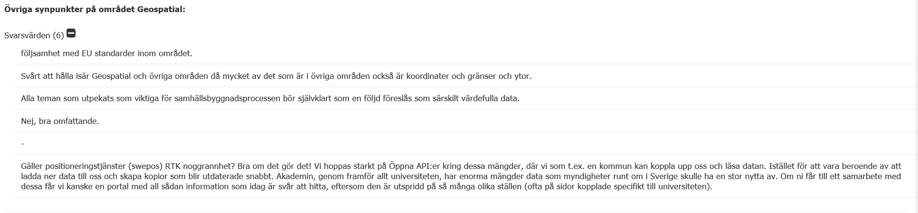
Geospatiala data

Slide 40
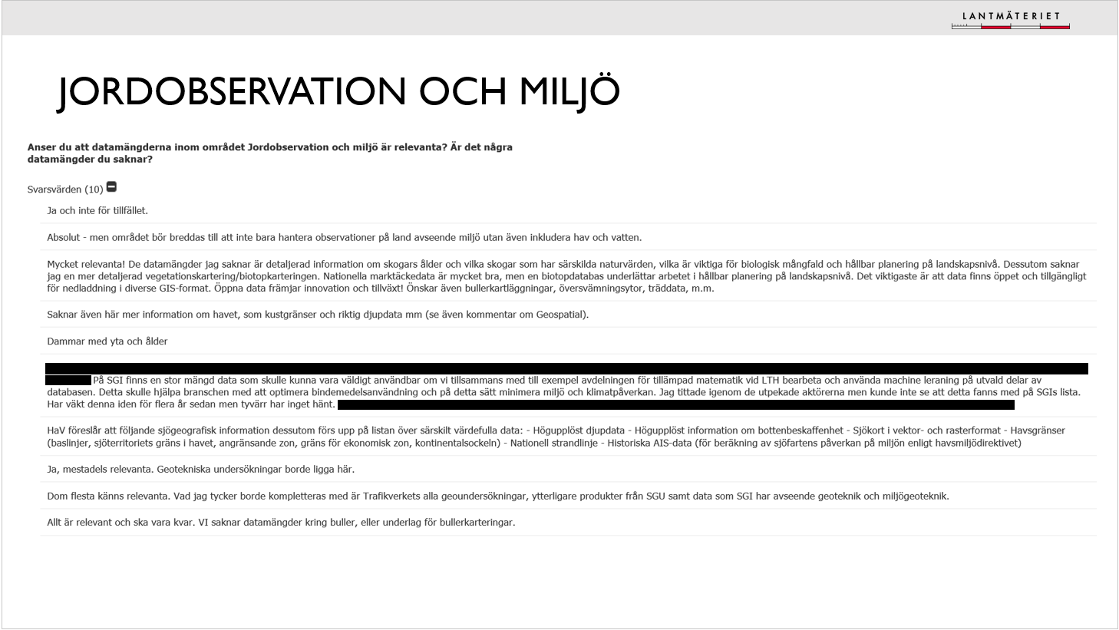
Jordobservation och miljö

Slide 41
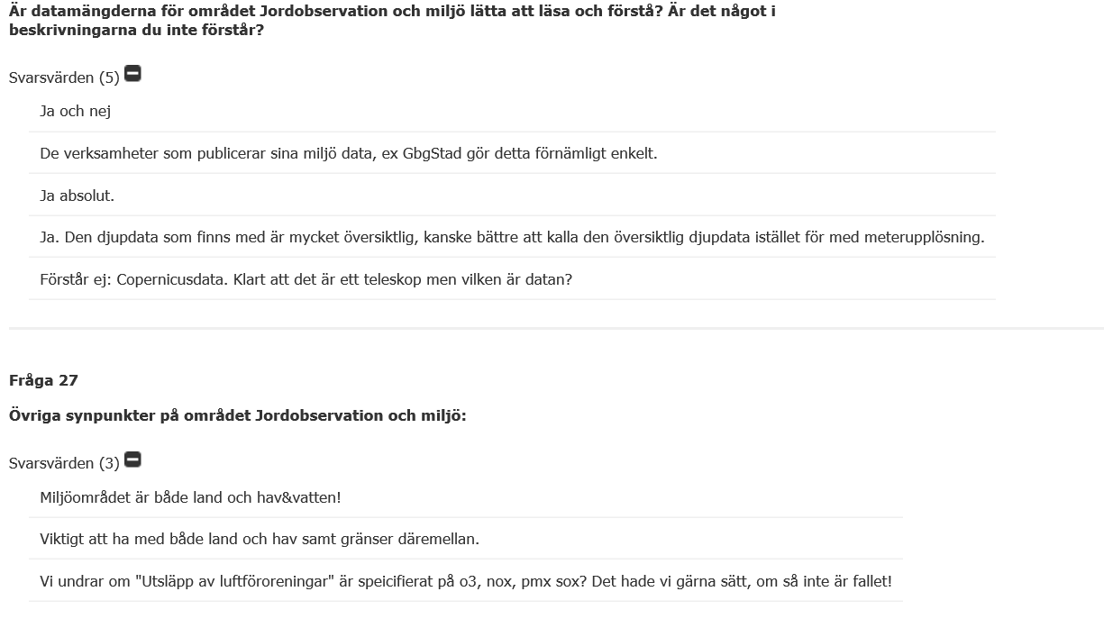
Jordobservation och miljö

Slide 42
rapportskrivning och Presentationsvy

Slide 43
rapport
Rapportskrivning pågår
Delrapport vs Slutrapport
Delrapport: Fokus på nyttoanalysen och budgetära konsekvenser men även förslagna datamängder
Slutrapport: kompletteras med finansieringslösningar samt ev förändringar i föreslagna datamängder
Vi behöver hjälp med texterna för presentationsnivån

Slide 44
Presentationsvy – obs utkast

Slide 45
Avstämning med ESV
Bra diskussioner
En till avstämning planeras

Slide 46
Nästa workshop
Nästa möte 7 april
Förslag på innehåll:
Slutrapportering nyttoanalys
Slutrapportering budgetära konsekvenser
Uppdatering av arbetet med Öppna data-utredningen
Delrapporten klar för förankring

Slide 47
Övriga frågor
Fråga: Already open for reuse betyder ju att det ska vara möjligt att vidareutnyttja = öppna data? Eller hur menar ni att de bara är tillgängliggjorda?
Svar: Efter diskussion med öppna-data-utredningen förstår vi att de tolkar skrivningen som tillgänglig snarare än på vilket sätt vilket gör att alla datamängder som finns och omfattas av PSI då räknas in. Vi fortsätter ta upp dettas i dialog med utredningen för att säkerställa att vi tolkar lika.
Fråga: Vart finns texterna vi kan lämna synpunkter på?
Svar: Texterna gäller beskrivningar av presentationsvyerna och har skickats som word-dokument via mail från PSI-lådan (då vi hade många problem med Antura så tar vi det säkra före det osäkra nu) Vill ni ha ett nytt utskick så hör av er.
Fråga: Har ni använt någon terminologi för presentationsvyn?
Svar: Presentationsvyn är inspirerad av beskrivningarna i UNGGIMs rapport om core data. För att föreslagna datamängder ska vara lätta att greppa och förstå utifrån ett helhetsperspektiv har vi grupperat ihop datamängderna och då har vi haft svårt att hitta några lämpliga redan existerande benämningar. Därför är det extra viktigt att ni hjälper oss att kika på beskrivningarna så att vi är överens om att de fungerar.
Fråga: hur är status i PSI-utredningen
Svar: se bild 4 om öppna-datautredningen.

